Slide 1
How to build websites on your own computer

Slide 2
SPRINT 1

Slide 3
Signing up for NinjaMock, Balsamiq or Figma
Create the UI Mock design
Task list display or task card display page consisting of
Creating a new task form consisting of
Editing a task form consisting of
TASK 1:
App Wireframes

Slide 4
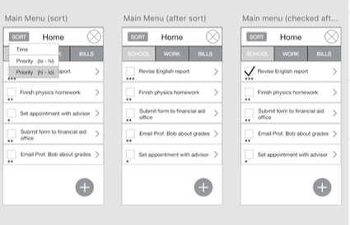

Slide 5
Get familiar with Bootstrap
Create a basic template using the Bootstrap starter template.
Create a form for Adding a new task.
TASK 2:
Implement your Wireframes using Bootstrap

Slide 6
In your index.html, create an "Add Task" button using Bootstrap buttons
The "Add Task" button should link to open up an "Add Task form." Use Bootstrap Modals and Bootstrap Forms to achieve this.
Create a layout similar to your mock designs using HTML and Bootstrap components
TASK 2:
Implement your Wireframes using Bootstrap

Slide 7
Verify that your "Add form" has the following elements
'Add Task' heading
Name -> textbox
Description -> textarea
AssignedTo -> textbox
DueDate -> textbox or datepicker [dd/mm/yyyy]
Status -> Dropdown select box [TODO, IN PROGRESS, REVIEW, DONE]
Submit button
Reset button
Use appropriate names/ids for labels and input boxes
TASK 2:
Implement your Wireframes using Bootstrap

Slide 8
Get familiar with Bootstrap Task card layout and List Groups
Create a Task card layout
In your index.html file, create a card layout in HTML and Bootstrap that represents a task card. You can also use list groups to list the tasks with a div slide down element that displays the details of the task.
Each card should display all details of the task including, task name, description, assignee, date and status.
TASK 3:
Create a Task Card layout / Task List component

Slide 9
Each task should also have an Edit button and Delete button. The edit button should link to open up the "Edit form" modal (Similar to the Add modal created in Step 1). The delete button deletes the task (This will be coded later in the project)
A button named "Add New Task" should open up the Task form
TASK 3:
Create a Task Card layout / Task List component

Slide 10

Closing
What did we learn today?

